Slide 1
The Squawk Java Virtual Machine
Doug Simon
    Sun Labs

Slide 2
Overview
Context and motivation
VM architecture & implementation
ARM port details
Lessons learnt
Future work

Slide 3
Context and motivation
Spotless & KVM experience
Alternative way to construct JVMs?
  Do it in Java!
    Pointer safety, exceptions, GC...
    More portable
    Ease of development
    Extend loader/verifier to simplify execution
What does this approach enable?
Goals:
  CLDC implementation for memory constrained devices
  Can run on bare metal (i.e. no OS required)

Slide 4
Architecture
Native
  Interpreter
  Platform IO
Java
  Translator
    Loader, verifier & bytecode transformation
  Core
    Thread scheduler
    Exception handling
    Synchronization
    Garbage collector
  Exporter
  JDWP Debug Agent
  CLDC API

Slide 5
Architecture
Translator
Interpreter
.class
suite

Slide 6
Split VM Architecture
Translator
Interpreter
.class
.suite
suite
Exporter

Slide 7
Architecture
Different configurations for different needs
Bootstrapping
  Used to create boot .suite file
Standard
  CLDC compliant JVM
  Used to create (non-boot) .suite files
Minimal
  Minimizes static and dynamic on-device memory requirements

Slide 8
Bootstrapping
Hotspot
Core
[Translator]
[Debug Agent]
[…]
Translator
.class
boot.suite
Exporter

Slide 9
Standard
Squawk
Core
Translator
.class
…
Interpreter
Platform IO

Slide 10
Minimal
Desktop
Device
Squawk
Squawk
Core
Application
Translator
Core
app.suite
.class
…
Interpreter
Interpreter
Platform IO
Platform IO

Slide 11
Suites
A suites is a preprocessed set of class files
Internally fully linked
  Pointers to other classes in suite or parent(s) only
  Chain of suites is a transitive class closure
Internal bytecode set optimized for:
  Space
  Simplified garbage collection
  Compilation
  In-place execution
    Requires pre-linking
    Enables deployment in ROM
    Improves startup time

Slide 12
Suite chain
boot
library
app

Slide 13
Space optimizations
2 byte branch
More 1 byte load/store/const instructions
2 byte field access
  Operand is object offset, not constant pool index
2 byte invoke
  Operand is vtable index, not constant pool index
Escape mechanism for:
  Float and double instructions
  Large operands (i.e. widened operands)

Slide 14
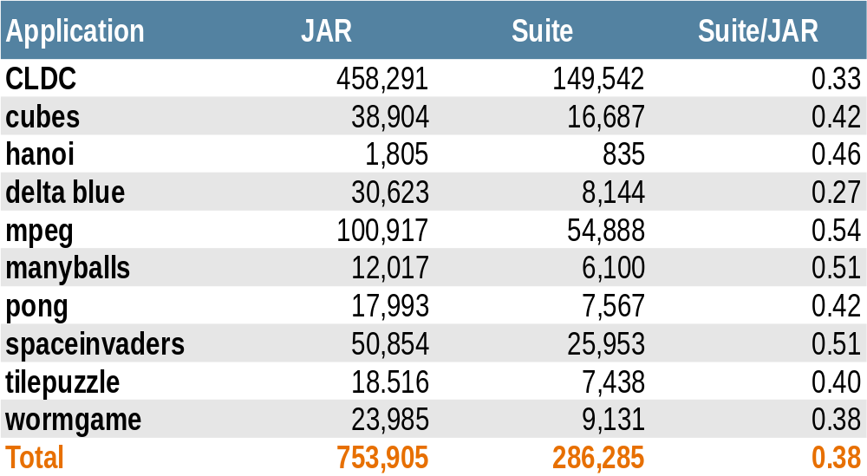
Uncompressed JAR vs Suite File Size Comparison

Slide 15
Simplified garbage collection
One pointer map per method
  Obviates need for stack maps and analysis during collection
  Requires extra slots
    Can be mitigated by slot re-allocation based on liveness analysis (instead of lexical scoping)
Java
Squawk
int + String
String
float + byte[]
byte[]
int
float
Activation records

Slide 16
Simplified garbage collection
Empty operand stack at GC points
  Same pros and cons
Normal Java
Squawk
Activation
record
Activation
record
Activation
record
Activation
record
Evaluation Stack
Activation
record
Activation
record

Slide 17
Object memory serialization
A graph of objects can be serialized to a connection (e.g. file, socket, ...)
Implemented as an extension to the garbage collector
Pointers in serialized suites are normalized
Can swap endianess on load and/or save
Used by exporter and…

Slide 18
Object layout
1 word objects headers, 2 words for arrays
Class pointer
Length
Object
Class pointer
Array
Interposed ObjectAssociation for hashcode/monitor
  Created on demand
Associative monitor used instead for ROM objects
  Rarely needed
  Hashcode is address

Slide 19
Method objects
Specialized byte array with variable length header
Header encodes:
  Defining class pointer
  Pointer map
  Type map (for non-object and non-int slots)
    Used by compiler
  Exception handler table
  Slots required for parameters, locals, operand stack
Tighter encoding for common case:
  No handlers, parameters<32, locals<32, stack<32
  4 words

Slide 20
Space optimized symbols and metadata
Symbols for a class encoded in a byte array
  Method signatures
  Field signatures
  Access flags
Method body metadata stored separately
  Line number tables
  Local variable tables
Can strip:
  Everything
  Private and package private members (library)
  Private (extendable library)

Slide 21
Garbage collector
M&C collector is based on lisp2 algorithm in Lins & Jones
Generational - sliding window for young gen
Slices (a la Monty) obviates need for extra header word for forwarding pointer
Bit vector for entire heap (3% overhead):
  Mark bits for collection space
  Write-barrier bits for old generation
Stop-the-world!
Can copy an object graph into a contiguous block - object serialization

Slide 22
slice table
slice table
Bit vector and marking stack
Bit vector and marking stack
Headers
high
low
A
a
Class_{off}
B
b
Class_{off}
A
memory
heap
B
slice 2
s2
C
s1
s0
D
slice 1
A
a + s2
B
E
C
c + s1
D
slice 0
d + s1
F
E
F

Slide 23
Isolates
Abstraction for an application in a JVM
Multiple isolates supported in single Squawk VM
Objects are:
  Logically isolated for each isolate
  Physically interleaved on heap
Non-shared class state:
  Static fields
  Class initialization state
  Class monitors
Immutable state is shared:
  Methods, string constants, classes (apart from above)

Slide 24
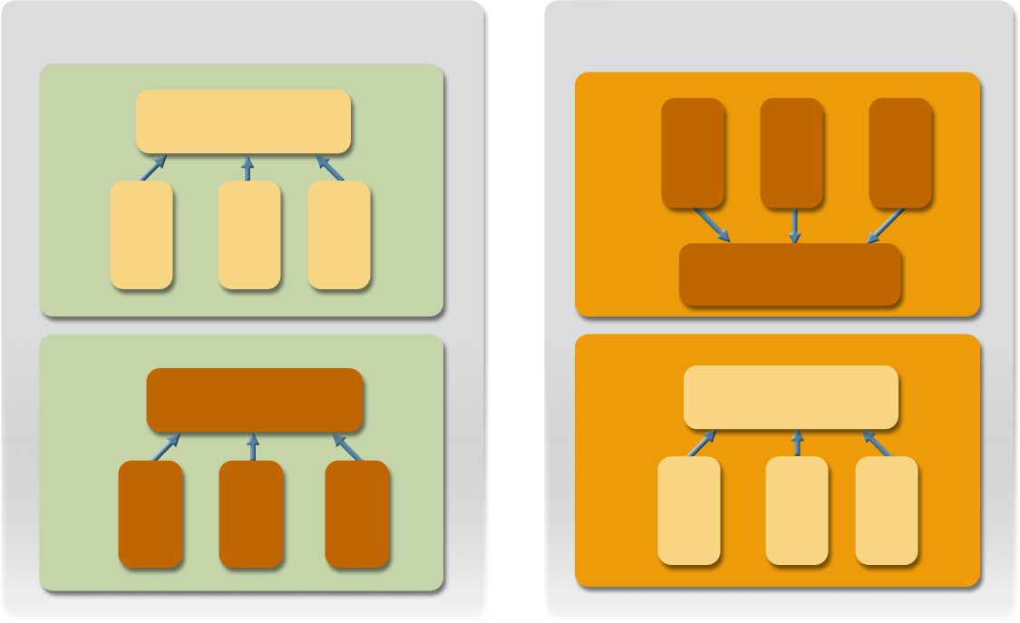
JVM Isolates and OS Processes Analogy
Operating System
Squawk JVM
Process
Isolate
Resources
thread1
thread2
thread3
thread1
thread2
thread3
Resources
Process
Isolate
Resources
Resources
thread1
thread2
thread3
thread1
thread2
thread3

Slide 25
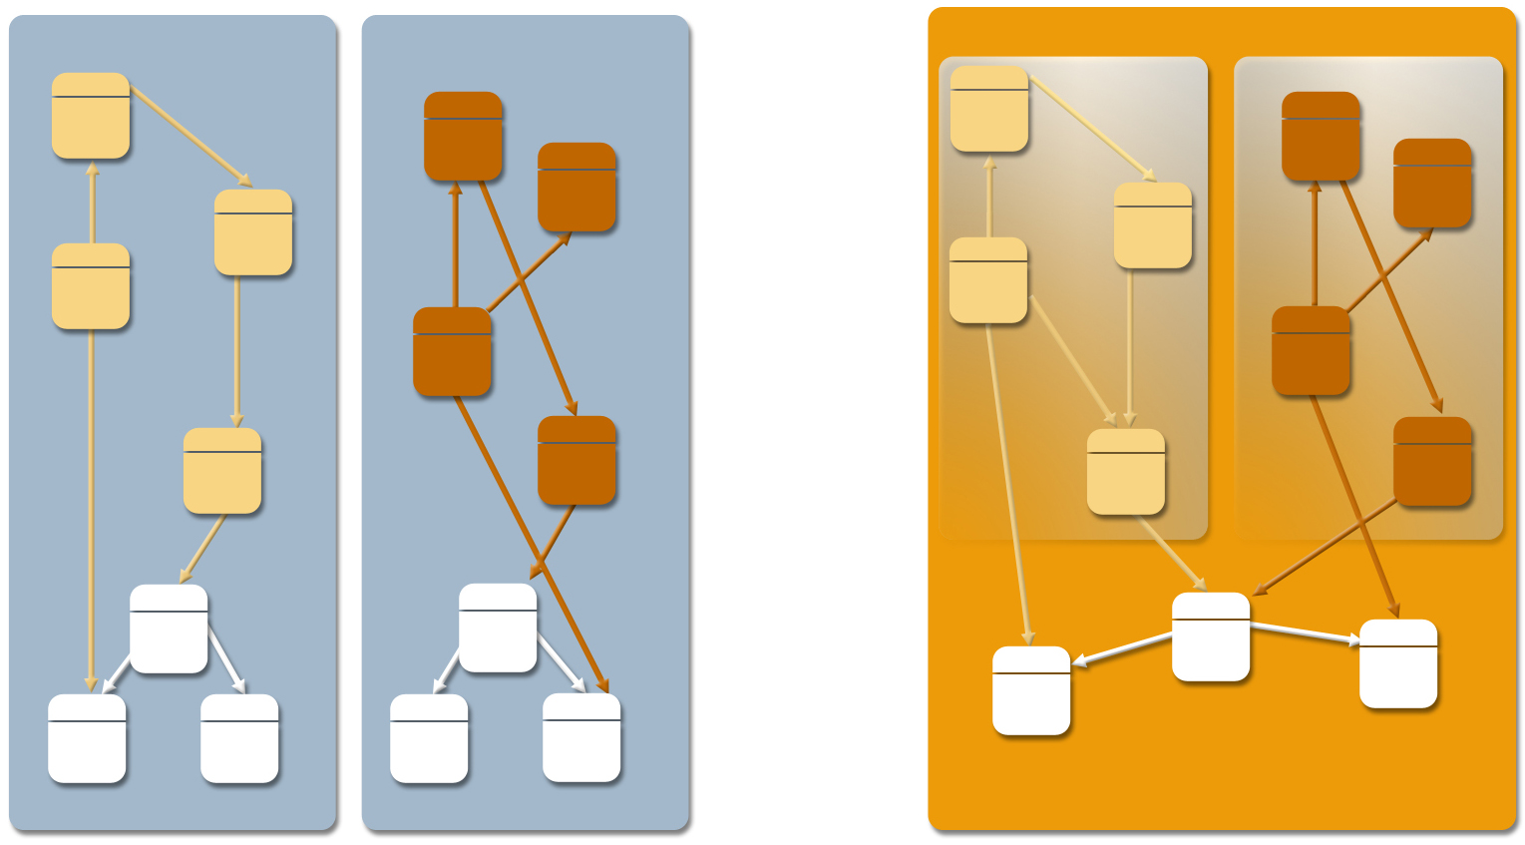
Shared memory for multiple isolates
Standard JVM
Squawk JVM
Isolate
Isolate
Non-shareable object memory
Shareable object memory
JVM OS process
JVM OS process
JVM OS process

Slide 26
Squawk Isolates
Similar to JSR 121
  No support for inter-isolate communication
Can be paused and resumed
Can be migrated
  Uses same object serialization mechanism as the Exporter
  Constraints on external state
    Must be none, OR
    Must be homogenous at both ends, OR (Sun SPOT)
    Must be serializable (desktop Squawk)

Slide 27
Thread scheduling
Green threads
Supports blocking in native methods
  Thread blocked on event queue polled by scheduler
  Events correspond to interrupt
Rescheduling done at backward branches
  bbtarget inserted by translator
System code is non-preemptible
  Simplifies VM greatly
  Assumes most execution is in application code
Requires explicit Thread.yield() in potentially long running system code
  E.g. System.arraycopy()

Slide 28
Compiler Interface
Stack based API with C-like semantics
Two categories of instructions:
  General purpose
    add(), sub(), eq(), push(), call()
  Interpreter generator specific
    alloca(), getIP(), getFP()
Intended to be used for:
  AOT compiling of boot suite
  JIT
  Interpreter generator

Slide 29
Prototype Compiler Implementation
One-pass compiler
  Uses shadow-stack representation
Simple register allocator
Implemented for x86 and ARM
TBD: integration with rest of system
Collaboration with U Sydney to develop optimizing implementation
  Probably too heavyweight for JIT but suitable for AOT
Experimental approach: results pending!

Slide 30
Porting to the ARM
Squawk ported to the ARM simulator in a week by someone external to VM team
Within 3 months, 2 contractors had it running on the Atmel ARM board
  Including the ARM Platform IO support
Complete system running on the Sun SPOT within 6 months
  Including sensor libraries, demo apps and build notes
Sun SPOT: Small Programmable Object Technology

Slide 31
Sun SPOT: Hardware
Hardware
  32-bit ARM core
  Chipcon CC2420 based wireless platform
  256K RAM, 2Mb FLASH
  SPI based peripherals
  Simple sensor board
    3D accelerometer
    Light sensor
    3 color LEDs
    9 I/O pins
    Temperature

Slide 32
Sun SPOT: Software
Minimal Squawk VM configuration
  350K static footprint:
    80K - Native + PlatformIO
    270K - Core + CLDC 1.0 library (bootstrap suite)
Device drivers written in Java
Libraries for
  Driving hardware: radio, sensor boards, ...
  Basic 802.15.4 network functionality

Slide 33
Sun SPOT + Squawk: Why?
Improve accessibility of sensor devices
Motes + nesC was considered hard to program
Java libraries alleviate a lot of infrastructure programming
Can use standard Java tools including a debugger!

Slide 34
Lessons & Observations
Problem: want to write highly factored VM code AND want great performance
Solution: Need optimizing AOT compiler!
Annotations useful for expressing VM specific constraints:
  method must be inlined (can't invokevirtual)
  method must never not do allocation
  public class must only be accessed by VM code

Slide 35
Lessons & Observations
Writing GC in Java was a double-edged sword
+ No need to duplicate definitions in C
- Hidden constraints: e.g. can't invoke virtual methods on object with corrupt header
- Very slow without AOT!
Don't couple VM code with standard core classes and namespaces
  Complicates bootstrapping
  Requires -Xbootclasspath and (even worse) -Dsun.boot.library.path (works differently in JDK 5.0!)

Slide 36
Future Work
Optimize Sun SPOT deployment:
  Improve interrupt handling latency
  Integrate optimizations in the translator
Complete the compiler and to validate (or otherwise) the compiler interface approach
Investigate resource management based on isolates
Port to a cell phone?
Open source

